Slide 1
Software Engineering
(CSE-415)
Testing techniques (Cont.)

Slide 2
BASIS PATH TESTING
Cyclomatic complexity is computed using a number of ways:
The number of regions corresponds to the cyclomatic complexity.
Cyclomatic complexity, V(G), for a flow graph G, is defined as:
V(G) = E – N + 2, where E is the number of flow graph edges, and N is the number of flow graph nodes.
Cyclomatic complexity, V(G), for a flow graph G, is defined as:
V(G) = P + 1, where P is the number of predicate nodes contained in the flow graph G.

Slide 3
Cyclomatic Complexity
Flow chart
Flow graph
Path 1: 1-11
Path 2: 1-2-3-4-5-10-1-11
Path 3: 1-2-3-6-8-9-10-1-11
Path 4: 1-2-3-6-7-9-10-1-11
1
1
2,3
Predicate node
2
6
4,5
R2
3
7
R3
8
R1
6
4
9
7
8
5
10
R4 (region)
9
10
Cyclomatic complexity
1. Flow graph has 4 regions
2. V(G) = 11 edges - 9 nodes +2 = 4
3. V(G) = 3 predicate nodes + 1 = 4
11
11

Slide 4
BASIS PATH TESTING
The flow graph has 4 regions. So, V(G) = 4
V(G) = 11 edges – 9 nodes +2 = 4
V(G) = 3 predicate nodes + 1 = 4

Slide 5
BASIS PATH TESTING
Deriving Test Cases:
Using the design or code as a foundation, draw a corresponding flow graph.
Determine the cyclomatic complexity of the resultant flow graph.
Determine a basis set of linearly independent paths.
Prepare test cases that will force execution of each path in the basis set.

Slide 6
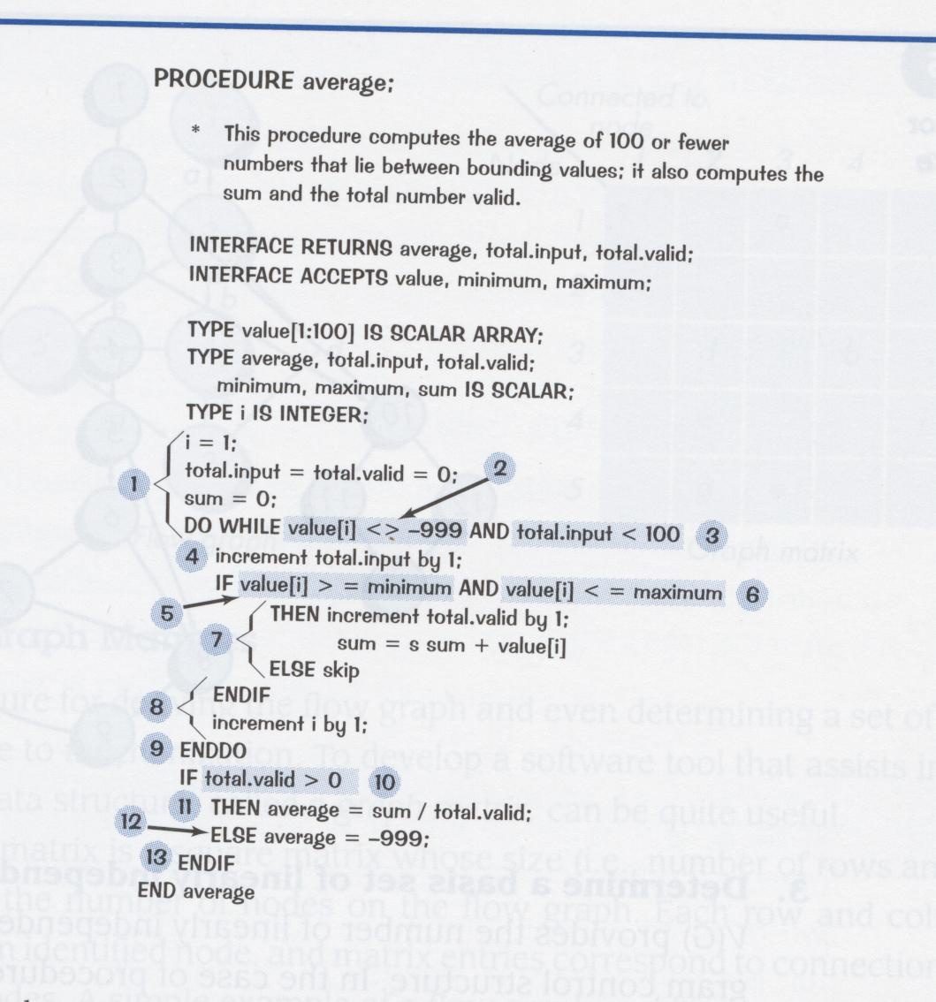
BASIS PATH TESTING
Figure 14.4: PDL with nodes identified

Slide 7
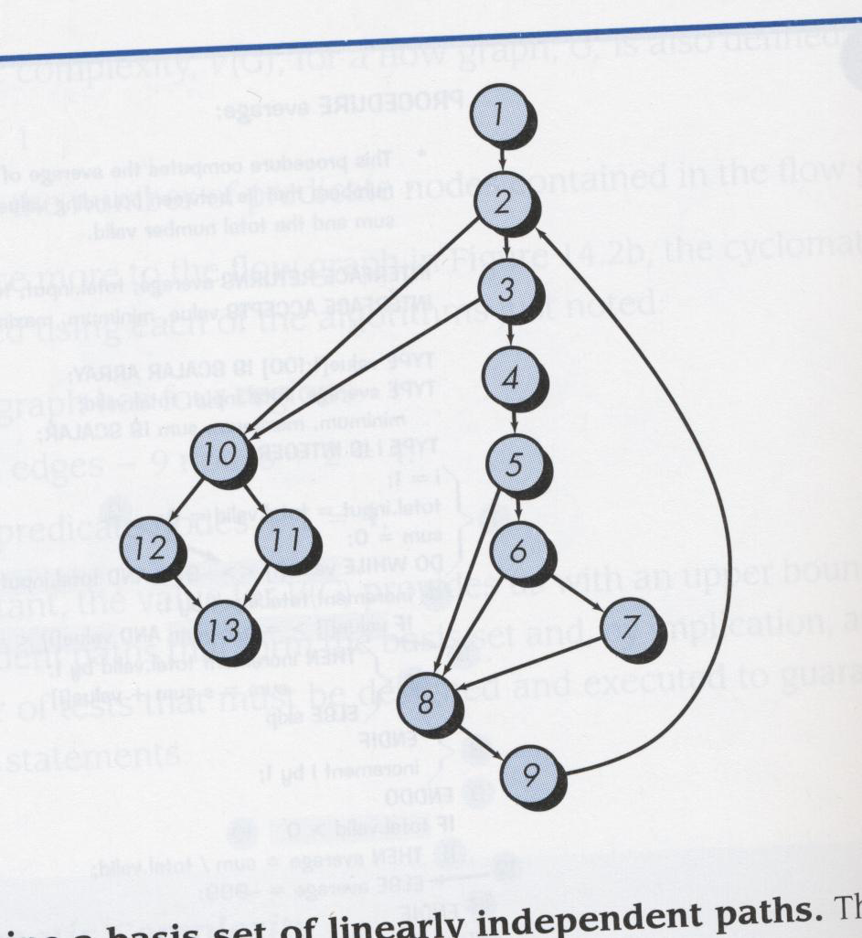
BASIS PATH TESTING
Figure 14.5
V(G) = 6 regions
V(G) = 17 edges – 13 nodes + 2 = 6
V(G) = 5 predicate nodes + 1 = 6

Slide 8
BASIS PATH TESTING
Paths:
Path 1: 1-2-10-11-13
Path 2: 1-2-10-12-13
Path 3: 1-2-3-10-11-13
Path 4: 1-2-3-4-5-8-9-2-…
Path 5: 1-2-3-4-5-6-7-8-2….
Path 6: 1-2-3-4-5-6-7-8-9-2…
Prepare test cases that will force execution of each path in the basis set.

Slide 9
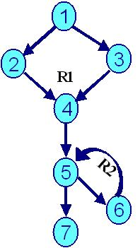
BASIS PATH TESTING : Another example
R3

Slide 10
BASIS PATH TESTING : Another example
What is the cyclomatic complexity, V(G)?
What are the independent paths?
What can you conclude from this?

Slide 11
BASIS PATH TESTING : Another example
Conclusion – 1: By getting a value of V(G) = 3 we conclude that it is a “well written” code, its “testability” is high and cost / effort to maintain is low.
Conclusion – 2: There are 3 paths in this program which are independent paths and they form a basis-set. These paths are described below:
    Path 1: 1 – 2 – 4 – 5 - 7
    Path 2: 1 – 3 – 4 – 5 - 7
    Path 3: 1 – 3 – 4 – 5 – 6 - 7
Conclusion – 3: We can form another basis-set as described below:
    Path 1: 1 – 2 – 4 – 5 - 7
    Path 2: 1 – 3 – 4 – 5 - 7
    Path 3: 1 – 2 – 4 – 5 – 6 - 7
Conclusion – 4: We must execute these paths at least once in order to test the program thoroughly. Accordingly we can design the test cases.

Slide 12
Control Structure Testing
White-box testing technique focusing on control structures present in the software.
The basis path testing technique is one of a number of techniques for control structure testing. Basis path testing is simple and effective; however, it is not sufficient in itself.
Following are some variations on control structure testing; they broaden testing coverage and improve quality of white-box testing –
  Condition testing
  Data flow testing
  Loop testing

Slide 13
Control Structure Testing
Condition testing:
Condition Testing is a test case design method that exercises the logical conditions contained in a program module.
Focuses on testing each condition in the program to ensure that it does not contain errors.
Types of errors found include:
  Boolean operator error (OR, AND, NOT)
  Boolean variable error
  Boolean parenthesis error
  Relational operator error (>,<,=,!=,…)
  Arithmetic expression error

Slide 14
Control Structure Testing
Condition testing:
A simple condition is a Boolean variable or a relational expression, possibly preceded with one NOT operator. A relational expression takes the form
E₁ <relational-operator> E_{2 ,}
Where E1 and E2 are arithmetic expressions, and
<relational-operator> is one of the following <, <=, =, <>, > or >=
A compound condition is composed of two or more simple conditions, Boolean operators, and parentheses.
Boolean operators allowed in a compound condition include OR, AND, and NOT.
Errors are much more common in the neighborhood of logical conditions than they are in the locus of sequential programming.

Slide 15
Control Structure Testing
Data Flow testing:
Data flow testing is a form of structural testing and a White Box testing technique that focuses on program variables and the paths:
  From the point where a variable, v, is defined or assigned a value
  To the point where that variable, v, is used
Data flow testing method selects test paths of a program according to the locations of definitions and uses of variables in the program.

Slide 16
Control Structure Testing
Data Flow testing:
A program unit accepts inputs, performs computations, assigns new values to variables, and returns results. One can visualize of “flow” of data values from one statement to another.
A data value produced in one statement is expected to be used later.

Slide 17
Control Structure Testing
Data Flow testing:
Anomaly: An anomaly is a deviant or abnormal way of doing something.
Data-flow anomalies represent the patterns of data usage which may lead to an incorrect execution of the code.
Examples of data flow anomaly:
  It is an abnormal situation to successively assign two values to a variable without using the first value==> Defined and then defined again
  It is abnormal to use a value of a variable before assigning a value to the variable ==> Undefined but referenced
  Another abnormal situation is to generate a data value and never use it ==> Defined but not referenced

Slide 18
Control Structure Testing
Data Flow testing:
Question: What to do after detecting a data flow anomaly?
The programmers must analyze the causes of data flow anomalies and eliminate them.
  Investigate the cause of the anomaly.
  To fix an anomaly, write new code or modify the existing code.

Slide 19
Control Structure Testing
Data Flow testing:
Question: Does the presence of data flow anomaly always mean that execution of the program will result in a failure?
Answer: Not always…
  The presence of a data flow anomaly in a program does not necessarily mean that execution of the program will result in a failure.
  A data flow anomaly simply means that the program may fail, and therefore the programmer must investigate the cause of the anomaly.

Slide 20
Control Structure Testing
Loop Testing:
Loop testing is a white-box testing technique that focuses exclusively on the validity of loop constructs.
Four types of loop can be defined –
  Simple
  Nested
  Concatenated
  Unstructured

Slide 21
Loop Types
Simple
Nested
Concatenated
Unstructured

Slide 22
Control Structure Testing
Loop Testing:
Simple Loops: The following tests should be performed for simple loops, where n is the maximum number of allowable passes through the loop:
      Skip the loop entirely
      Only one pass through the loop
      Two passes through the loop
      m passes through the loop where m < n
      n-1, n, n+1 passes through the loop

Slide 23
Control Structure Testing
Loop Testing:
Nested Loops: If we extended the simple loop test cases to nested loops, the number of tests would grow geometrically. Instead use the following scheme:
  Start at the innermost loop. Set all other loops to their minimum values.
  Conduct simple loop tests for the innermost loop while holding the outer loops at their minimum iteration parameter.
  Work outward, conducting tests for the next loop, but keeping all the other outer loops at minimum values and other nested loops to “typical” values.
  Continue until all loops have been tested.

Slide 24
Control Structure Testing
Loop Testing:
Concatenated Loops
  Concatenated loops can be tested using the approach defined for simple loops, if each of the loops is independent of each other.
  If the two loops are concatenated and the loop counter for loop 1 is used as an initial value of
  loop 2, then the loops are not independent.

Slide 25
Control Structure Testing
Loop Testing:
Unstructured Loops
  Can’t test unstructured loops effectively.
  Reflects very bad practice and should be redesigned.

Slide 26
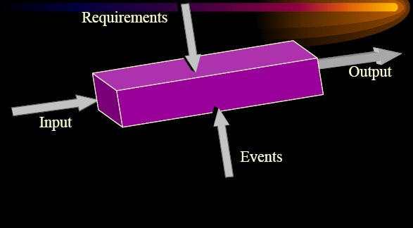
Black Box Testing

Slide 27
Black Box Testing
Black box testing is also called behavioral/functional testing.
Black box tests are designed to validate functional requirements without regard to the internal workings of a program.
Black box testing consists of a set of input conditions that will fully exercise all the functional requirements for a program.

Slide 28
Black Box Testing
Derives test cases using requirements, spec, user manual.
Internal implementation is not used.
Module being tested is considered to be a ‘black box'
whose behaviour is only determined by its inputs and related outputs.
Tester is purely concerned with whether the module performs the function it was intended to perform, as stated in the requirements.
Tester must exercise the normal behaviour, abnormal behaviour, and error conditions.
BBT is not an alternative to WBT. Rather it is a complementary approach to WBT.

Slide 29
Black Box Testing
Focuses on the functional requirements of the software including functions, operations, external interfaces, external data and information.
Attempts to find errors in the following categories :
  Incorrect or missing functions
  Interface errors
  Errors in external database access
  Behavior or performance errors
  Initialization and termination errors
Unlike WBT, which is performed early in the testing process, BBT tends to be applied during later stages of testing.

Slide 30
Black Box Testing
Black Box Testing Techniques
  Equivalence Partitioning
  Boundary Value Analysis
  Error Guessing

Slide 31
Equivalence Partitioning
Exhaustive testing, where every possible program execution sequence is tested, is impossible.
We need to partition the class of all possible inputs to try to simulate exhaustive testing - this technique is known as equivalence partitioning.
We divide up all possible inputs into equivalence classes.
A test with one member of an equivalence class will be the same as a test with all the members of that class.
Reduces the total number of test cases to be developed.

Slide 32
Equivalence Partitioning
Equivalence Partitioning is a black-box testing method that divides the input domain of a program into classes of data from which test cases are derived.
The input domain of a program is partitioned into a finite number of equivalence classes from which test cases are derived.
An equivalence class consists of a set of data that is treated the same by the program or that should generate the same result.
Test case design is based on an evaluation of equivalence classes for an input condition.

Slide 33
Equivalence Partitioning
The equivalence classes are identified based on the set of valid or invalid states for each input condition.
An input condition can be
  A specific numeric value
  A range of values
  A set of related values
  A Boolean condition

Slide 34
Guidelines for defining equivalence classes
If an input condition specifies a range(e.g. 1-12), one valid and two invalid equivalence classes are defined(e.g. 5, 0, and 13)
If an input condition requires a specific value(e.g. ‘m’) then one valid and two invalid equivalence classes are defined(e.g. ‘m’, ‘f’, and ‘_’)
If an input condition specifies a member of a set(e.g. ‘check pin’, ‘check balance’, ‘withdraw cash’), then one valid and one invalid equivalence classes are defined
If an input condition is Boolean, one valid and one invalid class are defined

Slide 35
Equivalence Partitioning: Example1
Consider we are writing a program for computing letter grades based on the numerical scores of students, where the input variable is Score. The rule of computing the grade is as follows:
Score | Grade
90~100 | A
80~89 | B
70~79 | C
60~69 | D
0~59 | F

Slide 36
Equivalence Partitioning: Example1
The input domain of Score can be partitioned into 5 valid equivalence classes and 2 invalid equivalence classes –
  Valid classes: 0~59, 60~69, 70~79, 80~89, 90~100
  Invalid classes: smaller than 0 and greater than 100
Any data value within a class is considered equivalence in terms of testing
Using the equivalence partitioning testing, we can reduce the test cases from 101 (assume 0 <= score <= 100) to 7

Slide 37
Equivalence Partitioning: Example2
A program which edits credit limits within a given range ($10,000 - $15,000) would have 3 equivalence classes:
  Less than $10,000 (invalid)
  Between $10,000 and $15,000 (valid)
  Greater than $15,000 (invalid)

Slide 38
Equivalence Partitioning
Why we should use Equivalence Partitioning when designing test cases?
  To reduce the number of test cases (by avoiding the redundant cases), hence reducing the testing time & cost
  To assure better test coverage, by testing all input classes, hence improve the test efficiency.

Slide 39
Boundary Value Analysis (BVA)
BVA extends equivalence partitioning by focusing on data at the “edges” of an equivalence class.
BVA is a test case design technique that complements equivalence partitioning. Rather than selecting any element of the equivalence class, BVA leads to the selection of test cases at the “edges” of the class.
Unlike equivalence partition that derives test cases only from input conditions, BVA derives test cases from both input conditions and output domain.

Slide 40
Boundary Value Analysis (BVA)
In addition to select test data “inside” an equivalence class, data at the “edges” of the equivalence class also need to be examined.
Based on programming experience, more errors are found at the boundaries of an input/output domain than in the “center”.
BVA is a technique that consists of developing test cases and data that focus on the input and output boundaries of a given function.
BVA should be performed after identifying the Equivalence Partitions of the software.

Slide 41
Boundary Value Analysis: Example
In the same credit limit example, boundary analysis would test:
  Low boundary plus or minus one ($9,999 and $10,001)
  On the boundary ($10,000 and $15,000)
  Upper boundary plus or minus one ($14,999 and $15,001)

Slide 42
Guidelines for BVA
  If an input condition specifies a range [a, b], test cases should be designed with value a and b, just above and below a and b
  Example: Integer D with input condition [-3, 5], BVA test values are -3, 5, -2, 6, -4, 4
  If an input condition specifies number values, test cases should be developed to exercise the minimum and maximum numbers. Values just above and below minimum and maximum are also tested
  Example: Enumerate data E with input condition: {3, 5, 100, 102}, BVA test values are 3, 102, 2, 4, 101, 103

Slide 43
Guidelines for BVA
Guidelines 1 and 2 are applied to output condition
4. If internal program data structures have prescribed boundaries(e.g., an array has a defined limit of 100 entries) make sure to design a test case to exercise the data structure at its boundary.
  Array input condition: Empty, single element, full element, out-of-boundary
  Search output condition: Element is inside array or the element is not inside array

Slide 44
Error Guessing
Based on the theory that test cases can be developed based on experience of the Test Engineer.
Test design technique in which the experience of the testers is used to
  Guess the probable kinds and location of defects in a system, and
  Design tests specifically to expose them

Slide 45
Error Guessing
Identify potential errors and design test cases based on intuition and experiences.
Test cases can be derived by making a list of possible errors or error-prone situations
  Empty or null lists
  Zero instances or occurrences
  Blanks or null strings
  Negative numbers
  Historical defects (need to maintain defect history)

Slide 46
Summary
Any questions?!??

